Slide 1
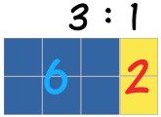
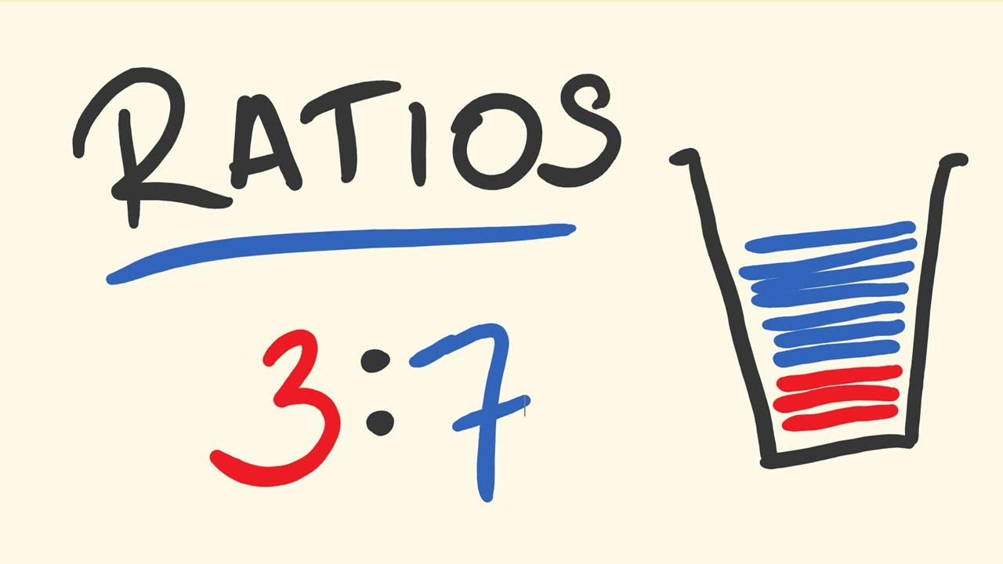
My Proportion Interactive Notebook
Name:
Class: 9-9
Teacher: Mr Evans
Term 2 Semester 1

Slide 2
Ratios Song
https://www.youtube.com/watch?v=-hcRMJcgpb4

Slide 3
Warm Up
Find the Greatest Common Factor of the following:
6 and 18
12 and 16
6 and 27
9 and 30

Slide 4
24
7
30
Date
Ratio
EQ – What is a ratio and how is it used?
What is a ratio?
Ratios are used to compare quantities with the same units.
The ratio of 2 to 5 is written as 2 : 5
How is a ratio used?
If you are making orange cordial and you mix one part cordial to four parts water, then the ratio of cordial to water will be 1:4 (1 to 4).
If you use 1 litre of cordial, you will use 4 litres of water (1:4).
If you use 2 litres of cordial, you will use 8 litres of water (2:8).
If you use 10 litres of cordial, you will use 40 litres of water (10:40).

Slide 5
24
7
30
Date
Ratio
EQ – What is a ratio and how is it used?
How is a ratio used?
These ratios are all equivalent
1:4 = 2:8 = 10:40
Both sides of the ratio can be multiplied or divided by the same number to give an equivalent ratio.
To simplify a ratio, you divide both sides of the ratio by the greatest common factor. Note: Make sure both sides of the ratio are using the same units of measurement.
Example:
200g : 1kg Change both sides to the same units
200g : 1000g Divide both sides by 200
1 : 5

Slide 6

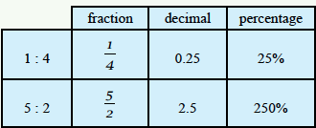

Let’s try some together.

Slide 7

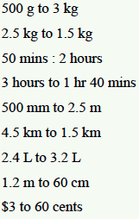

Slide 8
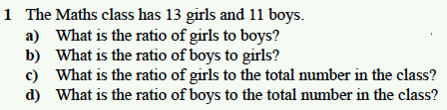

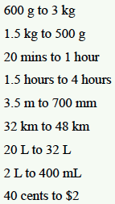

Complete the following on your own (use your notes if needed):
2.
3.
4.

Slide 9
Complete your Summary ensuring you explain the process you use to simplify ratios.

Slide 10
Notes Review
24, 7 ,30
Date
Title
Essential question
Notes complete
Notes complete with colour and diagrams
Questions completed
Contents page filed in
Formula page filled in

Slide 11
Homework
Review your notes and write a summary answering the essential question.

